Slide 1
DBMS FOR E-COMMERCE SECTOR
Ease the process of customers buying products online and sellers selling them
GROUP 4

Slide 2

MEET THE GROUP
Eshaan Joshi
Manish Parkar
Samiksha Garibe
Aditi Manikoth

Slide 3
PROBLEM STATEMENT
Creating a database management system for e-commerce sector using MySQL and python and executing various SQL commands to quickly analyze the data and to drawn some insights out of it.

Slide 4
INTRODUCTION TO E-COMMERCE
Internet has become an important medium for doing global business based on the state of the art technology. Global business was conducted in a new way: electronically, using networks and the Internet.
The availability of Internet has led to the development of E-Commerce (Electronic commerce), in which business transactions take place via telecommunication networks.
E-Commerce has two major aspects: economical and technological.

Slide 5
ROLE OF DATABASE MANAGEMENT SYSTEM IN E-COMMERCE
Ecommerce companies are always attempting to widen their net, pulling in more interested customers to view and purchase their products and services. With new consumers comes the potential for revenue and client referrals.
A database management system helps online businesses pinpoint possible customers and determine a strategy to push them through the sales funnel based on the information already on hand. Targeting their marketing efforts with these materials can help web-based businesses achieve the results they desire, while earning the trust and loyalty of good customers along the way.

Slide 6

With the assistance of database management software , retailers in web-based businesses can use existing customer profiles to recommend products and services they may enjoy based on previous purchases and interests.

Slide 7
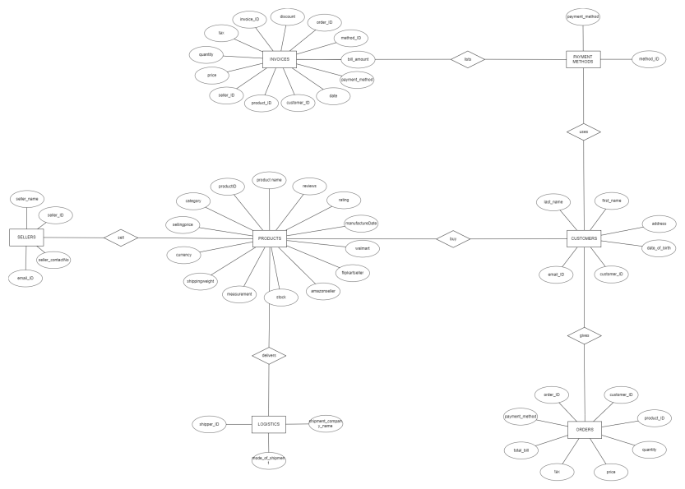
ER - DIAGRAM

Slide 8
INTRODUCTION TO DATABASE
Our database consists of 7 tables
This database has been created using python
Tables | Field Names
1. Customers | Index, first_name, last_name, address,date_of_birth, customer_ID,Email_ID
2. Invoices | Invoice_ID, order_ID, customer_ID,product_ID,seller_ID, Price, quantity,tax,discount,bill_amount, payment_method ,method_ID , Date ,
3. Logistics | Shipper_ID, Shippment_company_name, mode_of_shippment

Slide 9
Tables | Field Names
4. Orders | Order_ID , Customer_ID , Product_ID , Quantity , Price, Tax, Total_Bill , Payment_Methods
5. Payment_methods | Payment_Method ,Method_ID
6. Products | Product_ID , ProductName, Category, ShippingWeight , Measurement , Stock , AmazonSeller , FlipcartSeller, Walmart , ManufactureDate , Rating , Reviews
7. Sellers | Seller_ID , Seller_name , SellerContactNo , email_ID

Slide 10
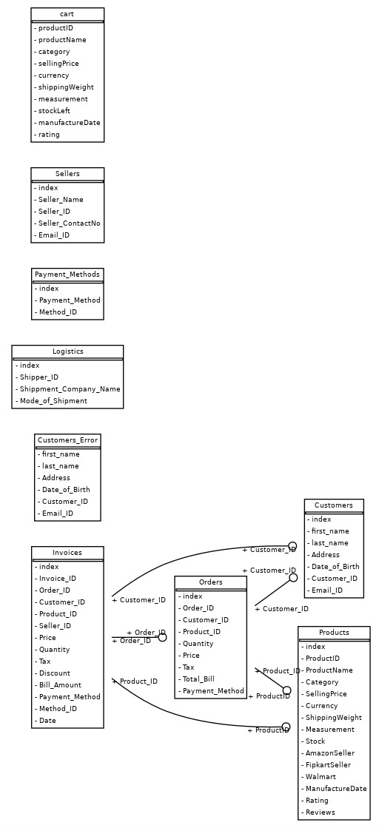
SCHEMA DIAGRAM

Slide 11
CONCLUSION
We as a team have successfully implemented our ideas and thought in our DBMS Case Study by using some tools such as MySQL, python, PowerPoint, etc., and collecting information from some links and sources and by using this we have created a E-commerce database to quickly analyze and come across some insights and conclusions of the data that we have created about the products, customers, sellers, shipping details, etc. in more efficient way and at last but not least we have enjoyed working on this project as a team and have successfully completed it.

Slide 12
THANK YOU!

